Slide 1
CHAPTER 22
Advanced practices and
future evolution

Slide 2
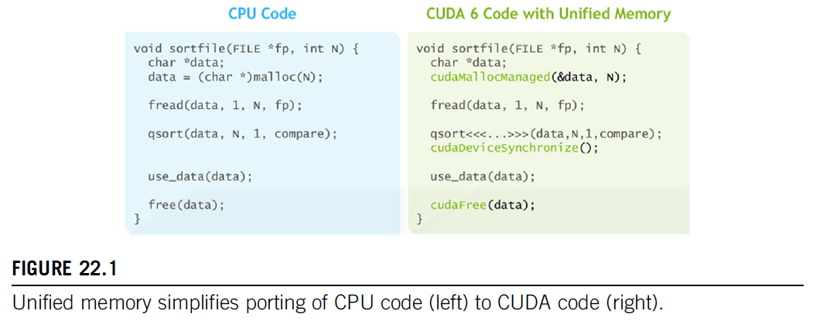

Slide 3
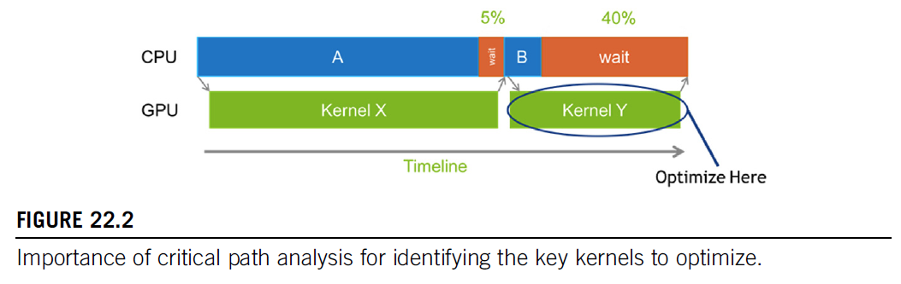

Slide 4
